Slide 1

Houses: The Lost American Dream
Python Project Team Members: Marvina L., Ciin Cing, Dren L.

Slide 2
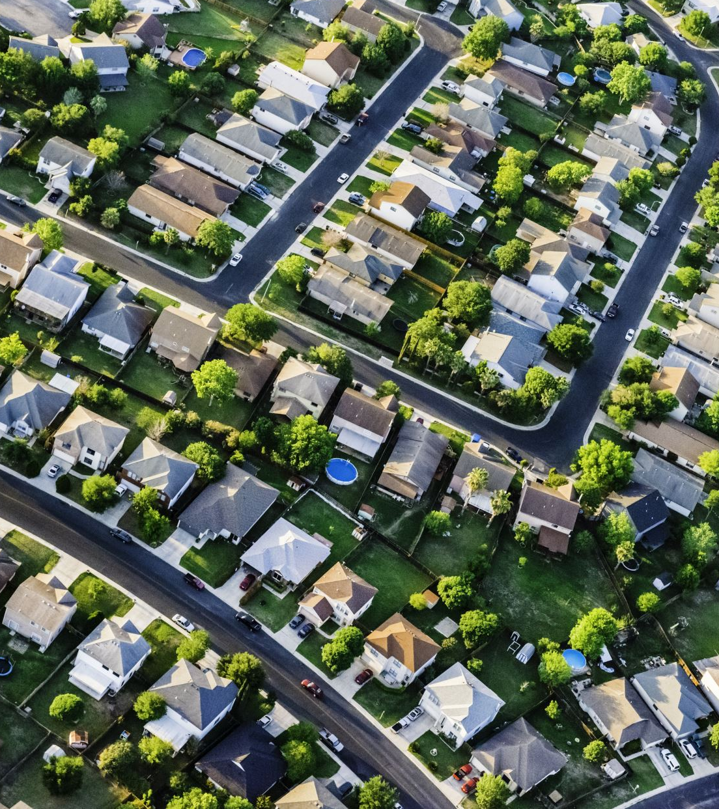
Project Details
Our project focuses on Home Prices and Interest Rates in key states and the US overall with a comparative analysis of the two key components of the hypothesis

Slide 3

Where we got our data
This is our data sources:
https://www.kaggle.com/datasets/federalreserve/interest-rates
https://www.bankrate.com/banking/federal-reserve/history-of-federal-funds-rate/#2001
https://fred.stlouisfed.org/series/MDSTHPI
https://fred.stlouisfed.org/series/TXSTHPI#0
https://fred.stlouisfed.org/series/CTSTHPI
https://fred.stlouisfed.org/series/USSTHPI
https://www.macrotrends.net/2015/fed-funds-rate-historical-chart

Slide 4

hypothesis
We predict the average home price in CT, MD, TX,WA and the US will have a direct correlation with the Federal Funds interest Rate

Slide 5

Data CLEANING, MODIFICATION & merging
After gathering the different sources of data

Slide 6
CLEANING & MERGING of data
After reading in and identifying which datatypes were in the .csv files
A datetime function was used to convert the date datatypes
Re-formatted column names for data uniformity; and to ensure a successful merge
A concat( ) was used to merge six .csv files
A group decision was made to avoid missing values in our data: we would adjust the time frame used in our Project to ensure there would be no missing values

Slide 7
Modification of data
There were a few modifications and updates needed for the sheets including renaming columns, cutting down a few raw csv.files and rearranging dates to appear like the other sheets we had cleaned.
Some of the functions used were pandas DataFrame, averaging monthly numbers for Quarters, .datetime, read.csv, dt.to_period, dt.to_timestamp, and others.
Once these modifications were made, we were able to seamlessly connect our sheets together to be easily turned into graphs and plots that could be read visually.

Slide 8

Plotting the data
In order to graph lines, dataset had to align values.
Cut down our timeline from 2023 to 2016
To create a graph with multiple line plots and two y-axes because interest rates and housing prices were on different scales.
Created variables with x = year & y = state/U.S/int
To combine the two axes:
After that, just label, title, add color, and create a legend.

Slide 9
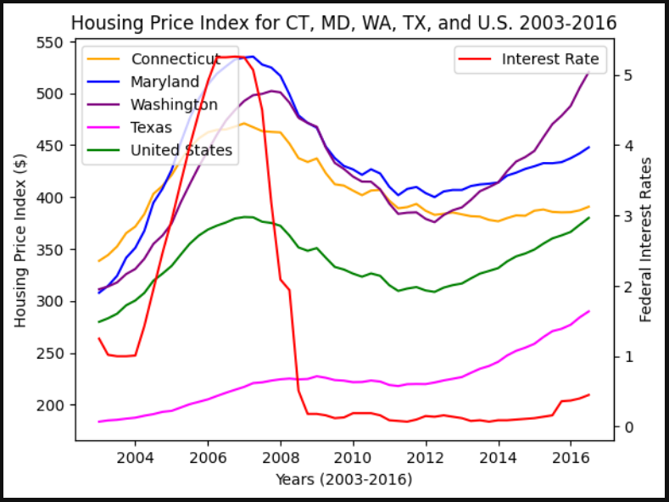
Final graph visualization
In this composite graph, 4 states (CT, MD, TX, WA) were originally aligned with the Federal Interest Rate. Then in 2008, there was a sharp decline in the interest rate, which was caused by the housing crisis of 2008 and a change in the Federal Reserve policy.

Slide 10
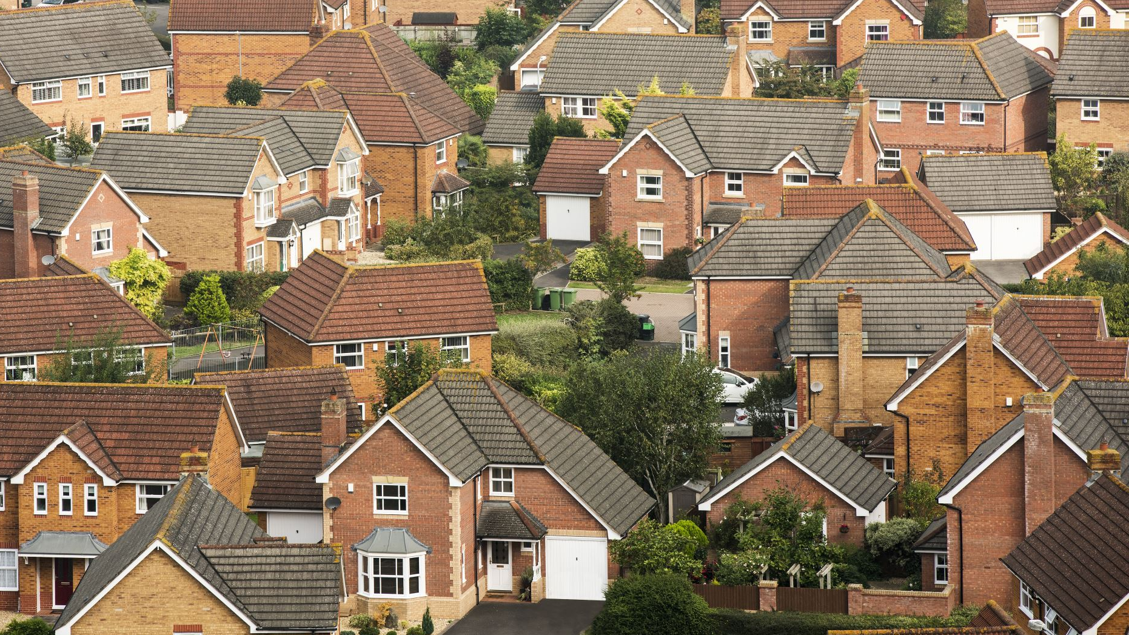
conclusion
Home prices in the markets we analyzed weren’t as significantly impacted by fluctuations in interest rates as initially hypothesized. Home prices decreased at a slower rate, we believe, due to government interventions to stimulate home sales after the housing bubble burst in 2008.
When the interest rate was cut sharply in 2008, due to the housing crisis, house sales decreased while home prices remained unaffected. The lines in our graphs display a sudden decline in the interest rate, while the State HPIs remain steady.
Overall, we believe our hypothesis was proven to be only partially correct. The data revealed that changes in the Federal interest rate did have significant impacts on the markets analyzed initially, but other factors decreased its effect considerably during the years following 2008.

